Slide 1


Fabio Ferri
February 2023

Slide 2
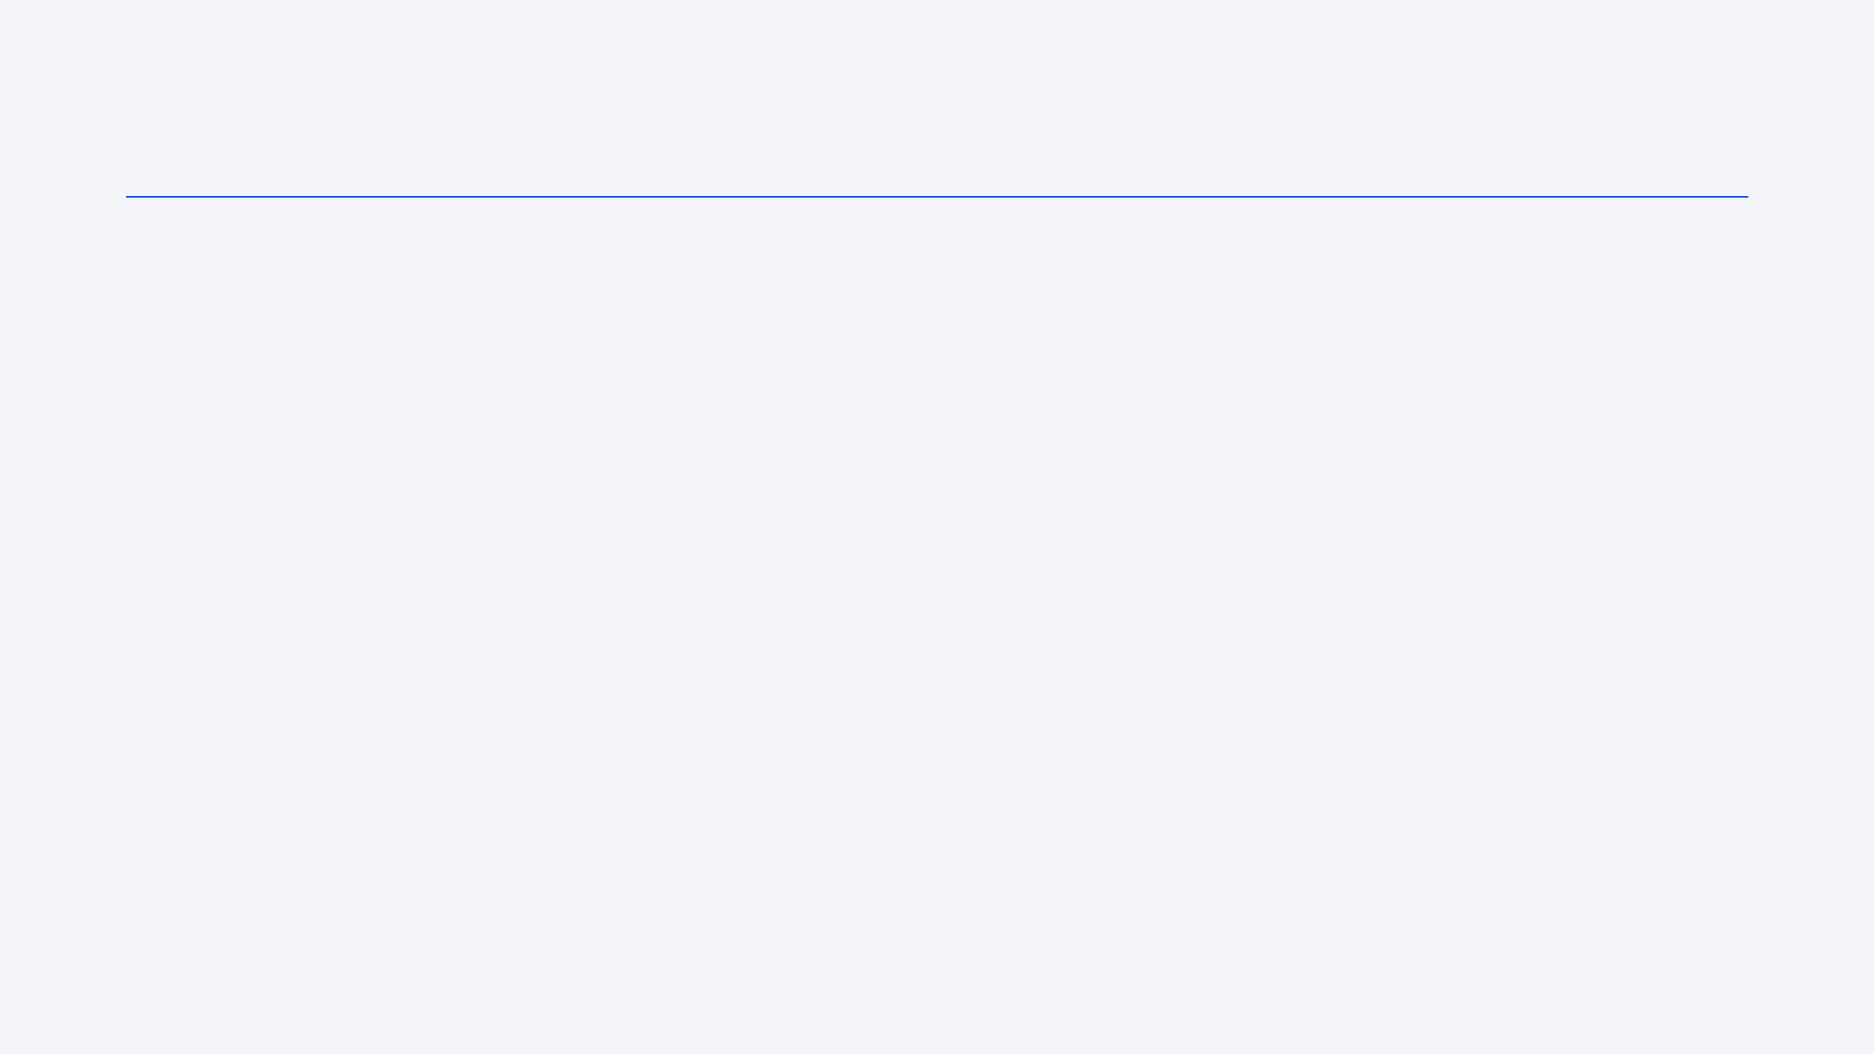
Outline
Executive Summary
Introduction
Methodology
Results
Conclusion
Appendix

Slide 3
Executive Summary
Summary of methodologies
Summary of all results

Slide 4
Introduction
Project background and context
In this capstone, we will predict if the Falcon 9 first stage will land successfully. SpaceX advertises Falcon 9 rocket launches on its website, with a cost of 62 million dollars; other providers cost upward of 165 million dollars each, much of the savings is because SpaceX can reuse the first stage. Therefore if we can determine if the first stage will land, we can determine the cost of a launch. This information can be used if an alternate company wants to bid against SpaceX for a rocket launch. The main goal of project is predict best Machine Learning method first stage land Successfully.
Problems you want to find answers
Find the best landing rate and Success Landing and Outcome.
Find the best labels to best approach model.

Slide 5

Section 1

Slide 6
Methodology
Executive Summary
Data collection methodology:
Data Collection API Xpace4
Data Web Scrapping Wikipedia
Perform data wrangling
Enrich, normalize, standardized Data Collected. ,

Slide 7
Methodology
Executive Summary
Perform exploratory data analysis (EDA) using visualization and SQL
Perform interactive visual analytics using Folium and Plotly Dash
Perform predictive analysis using classification models
Data were collected, normalized, standardized and split in training and test data sets and evaluated by four different classification models, to get the accuracy of each model evaluated.

Slide 8
Data Collection
Describe how data sets were collected.
Datasets were collected from SpaceX API (https://api.spacexdata.com/v4/rockets/) from python client API code.
Elementary labels columns
Dataset from Wikipedia (https://en.wikipedia.org/wiki/List_of_Falcon/_9/_and_Falcon_Heavy_launches), using web scraping python BeatfullSoup api.
Complement Data labels columns

Slide 9
Data Collection – SpaceX API
SpaceX offers a public API from where data do be collected.
GitHub URL of the completed SpaceX API calls notebook: https://github.com/FabioFerri2907/IBMDataScience/blob/master/Curso10-Applied%20Data%20Science%20Capstone/Week1/Lab1-DataCollecting-API.ipynb
Request and parse the SpaceX launch data using the GET request
Filter Falcon 9
Dealing with Missing Values

Slide 10
Data Collection - Scraping
Web Scracping Data Collection to add more complement labels features.
GitHub URL of the completed web scraping notebook: https://github.com/FabioFerri2907/IBMDataScience/blob/master/Curso10-Applied%20Data%20Science%20Capstone/Week1/Lab1-DataCollecting-API.ipynb
Request Request the Falcon9 Launch Wiki page from its URL
Extract all column/variable names from the HTML table header
Create a data frame by parsing the launch HTML tables

Slide 11
Data Wrangling
Normalization Data and Format
Missing null values , replace by mean value labels.
Transform Labels to Outcome Labels to Success or Fail , land, payload mass, orbit, e.g )
GitHub URL:
https://github.com/FabioFerri2907/IBMDataScience/blob/master/Curso10-Applied%20Data%20Science%20Capstone/Week1/Lab_DataWrangling_FF.ipynb

Slide 12
EDA with Data Visualization
Exploratory Data Analysis and Feature Engineering have got:
LEO orbit the Success appears related to the number of flights.
Success rate since 2013 kept increasing till 2020.
With heavy payloads the successful landing or positive landing rate are more for Polar,LEO and ISS.
Payload mass have been increased since begin flights from aproxly < 2000 KG to today above 16.000 kg.
CCAFS LC-40, has a success rate of 60 %, while KSC LC-39A and VAFB SLC 4E has a success rate of 77%.
GitHub URL: https://github.com/FabioFerri2907/IBMDataScience/blob/master/Curso10-Applied%20Data%20Science%20Capstone/Week2/Lab-FF-EDAwithDataVisualization.ipynb

Slide 13
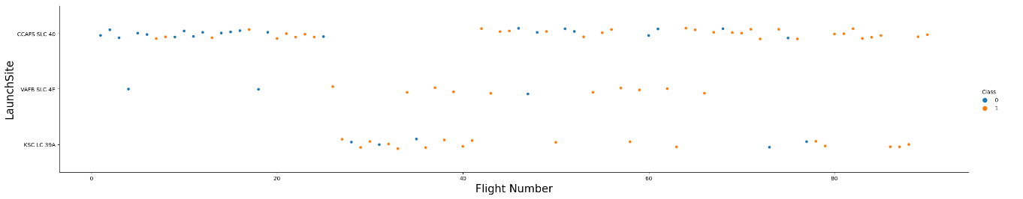
EDA with SQL
Compare Scatterplots using :
Payload Mass X Flight Number
Launch Site X Flight Number
Launch Site X Payload Mass
Orbit and Flight Number
Payload and Orbit
GitHub URL: https://github.com/FabioFerri2907/IBMDataScience/blob/master/Curso10-Applied%20Data%20Science%20Capstone/Week2/Lab-FF-EDAwithDataVisualization.ipynb

Slide 14
Build an Interactive Map with Folium
All Launch Sites were marked with circle
Mark the success/failed launches for each site on the map
Calculate the distances between a launch site to its proximities
GitHub URL: https://github.com/FabioFerri2907/IBMDataScience/blob/master/Curso10-Applied%20Data%20Science%20Capstone/Week3/Lab3_Dashboards_FF_feito.ipynb

Slide 15
Build a Dashboard with Plotly Dash
It have been added and Dropdown for all Lauch sites.
A pie chart to show the total successful launches count for all sites.
We plotted scatter graph showing the relationship with Outcome and Payload Mass (Kg) for the different booster version.
GitHub URL: https://github.com/FabioFerri2907/IBMDataScience/blob/master/Curso10-Applied%20Data%20Science%20Capstone/Week3/spacex_dash_app.py

Slide 16
Predictive Analysis (Classification)
Load DataSet into DataFrame Pandas e Numpy array.
Standarlize the data X variables.
Set train and set tests 80% to Train/20 % to Test.
Create a four Machine Learnings methods:
Logistics Regression
Support Vector Machine
Decision tree
KNN neighbors
Find the method performs best
Evaluate the best accuracy four models
GitHub URL: https://github.com/FabioFerri2907/IBMDataScience/blob/master/Curso10-Applied%20Data%20Science%20Capstone/Week4/SpaceX_Machine%20Learning%20Prediction_Part_5_FF_Labs.ipynb

Slide 17
Results
Exploratory data analysis results
Space X uses 4 different launch sites.
The first launches were done to Space X itself and NASA.
The First Success launch was in 2015.
Payload Mass have been increasing last years.
KSC LC-39A and VAFB SLC 4E has a success rate of 77%,
CCAFS LC-40, has a success rate of 60 %.
The number of landing outcomes became as better as years passed.
They have had positive landing rate are more for Polar,LEO and ISS orbit.

Slide 18
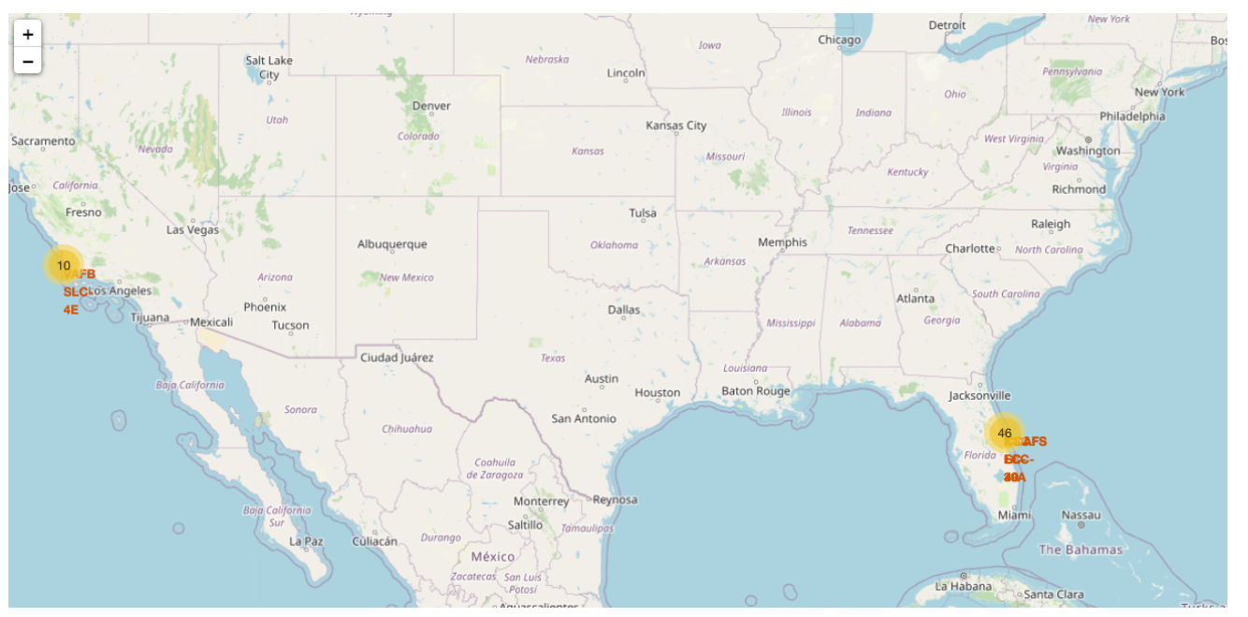
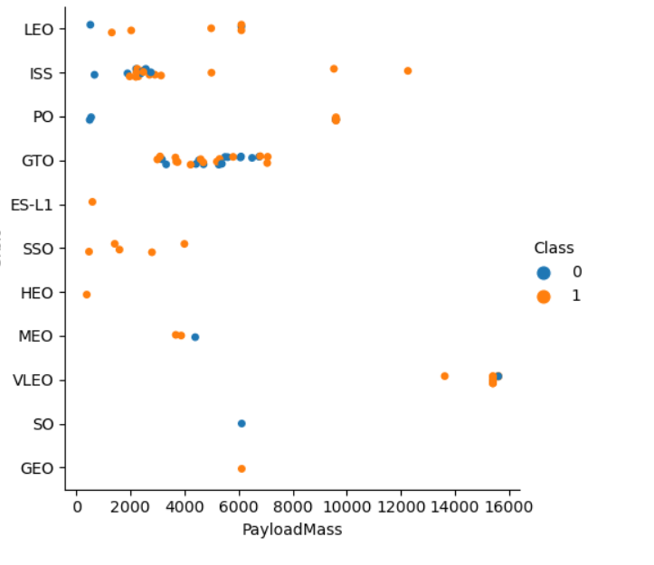
Results
Most of launch sites are near to sea, cost line and high , because good logistic.
LEO, VLEO and SSO are the best rate success outcomes.
Polar,LEO and ISS the highest payload mass.

Slide 19

Section 2

Slide 20
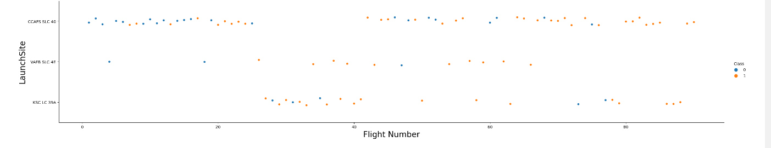
Flight Number vs. Launch Site
CCAFS SLC 40 have the most of numbers of flight.
The status success rate have been increase the last flights.

Slide 21
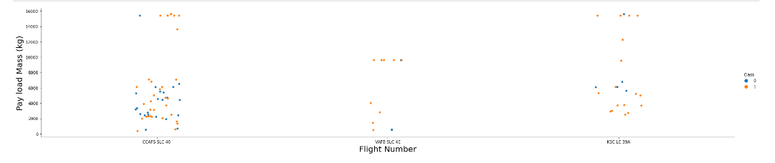
Payload vs. Launch Site
CCAFS SLC 40 and KSC LC39A site has both have Success or Fail flight, whereas VAFB SLC 4E has more success rate.

Slide 22
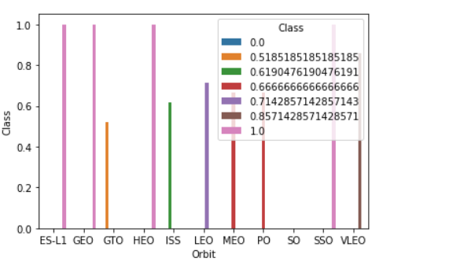
Success Rate vs. Orbit Type
ES-L1, GEO, HEO and SSO, have best success rate.
GTO, MEO and Polar the worst rate.

Slide 23
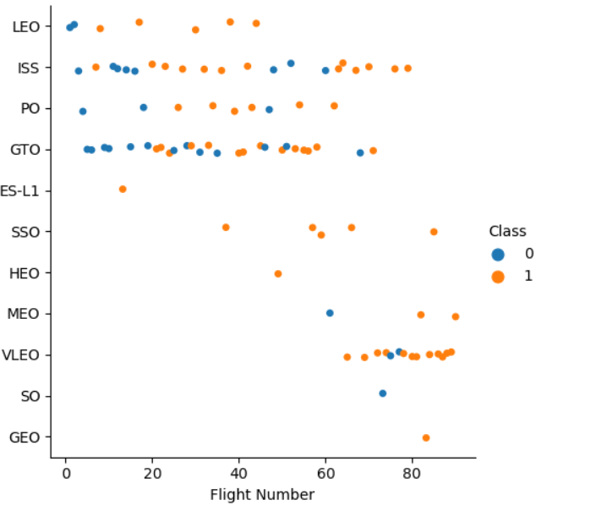
Flight Number vs. Orbit Type
LEO, SSO and VLEO have had the success rate.
GTO and ISS have the worst rate.
SSO have 100% Success rate.

Slide 24
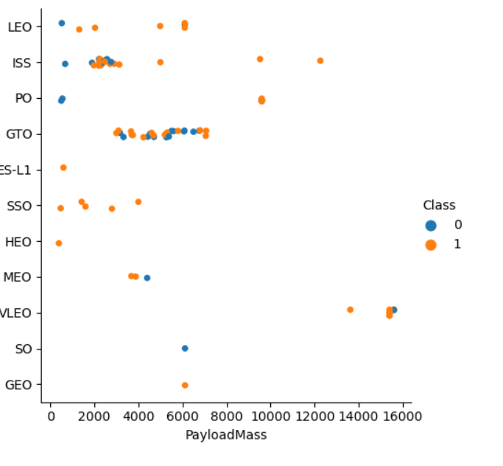
Payload vs. Orbit Type
ISS, PO and VLEO are the highest heavy payload.

Slide 25
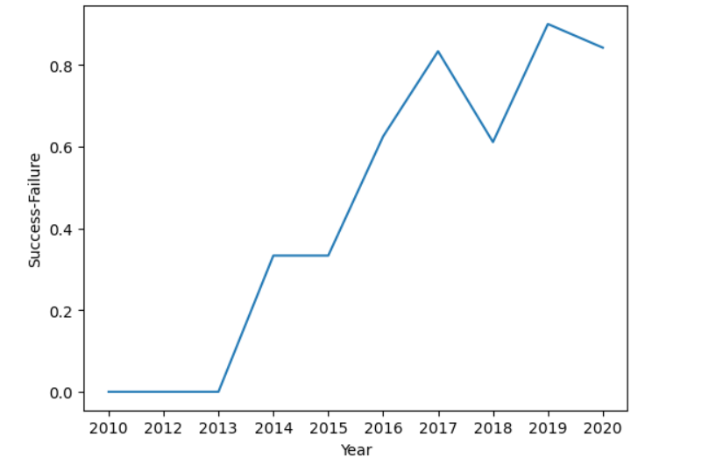
Launch Success Yearly Trend
We can observe that the success rate since 2013 kept increasing till 2020.

Slide 26
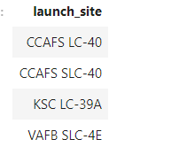
All Launch Site Names
Fours Launch Sites found.
DISTINC command used to get unique name.

Slide 27
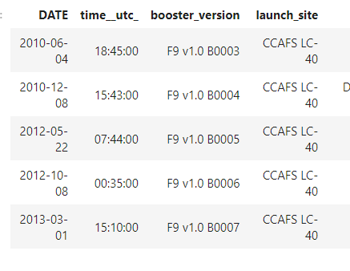
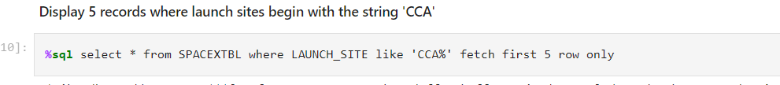
Launch Site Names Begin with 'CCA'
Find 5 records where launch sites begin with `CCA`
SQL Like command used to filter ‘CCA’

Slide 28
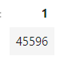
Total Payload Mass
Calculate the total payload carried by boosters from NASA are 45.596 Kg.
SUM command to PAYLOAD_MASS_KG where NASA (CRS).

Slide 29
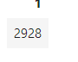
Average Payload Mass by F9 v1.1
The average payload mass carried by booster version F9 v1.1 is 2928 Kg.
The AVG command to get mean PAYLOAD_MASS_KG where BOOSTER_VERSION = F9 V1.1

Slide 30
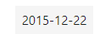
First Successful Ground Landing Date
22th December 2015 of the first successful landing outcome on ground pad
Min command in Data field where LANDING_OUTCOME = 'Success (ground pad)'

Slide 31
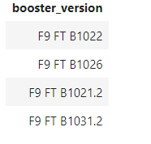
Successful Drone Ship Landing with Payload between 4000 and 6000
List the names of boosters which have successfully landed on drone ship and had payload mass greater than 4000 but less than 6000
Between command 4000 to 6000 in PAYLOAD_MASS_KG to get BOOST_VERSION.

Slide 32
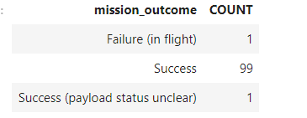
Total Number of Successful and Failure Mission Outcomes
Successful Outcomes 99%
Failure Outcomes 1%
Count command MISSION_OUTCOME and GROUP BY used to get Total Number MISSION_OUTCOME field.

Slide 33
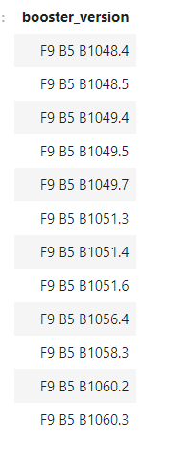
Boosters Carried Maximum Payload
List the names of the booster which have carried the maximum payload mass
Used a subquery to get MAX payload Mass and used it where in fisrt query to DISTINC COMMAND by BOOSTER_VERSION.

Slide 34
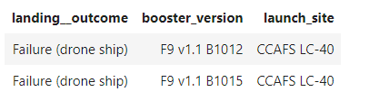
2015 Launch Records
List the failed landing_outcomes in drone ship, their booster versions, and launch site names for in year 2015.
Just Where SQL by Date and Landing Outcome filter

Slide 35
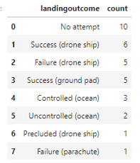
Rank Landing Outcomes Between 2010-06-04 and 2017-03-20
We selected Landing outcomes and the COUNT of landing outcomes from the data and used the WHERE clause to filter for landing outcomes BETWEEN 2010-06-04 to 2010-03-20.
We applied the GROUP BY clause to group the landing outcomes and the ORDER BY clause to order the grouped landing outcome in descending order.

Slide 36

Section 3

Slide 37
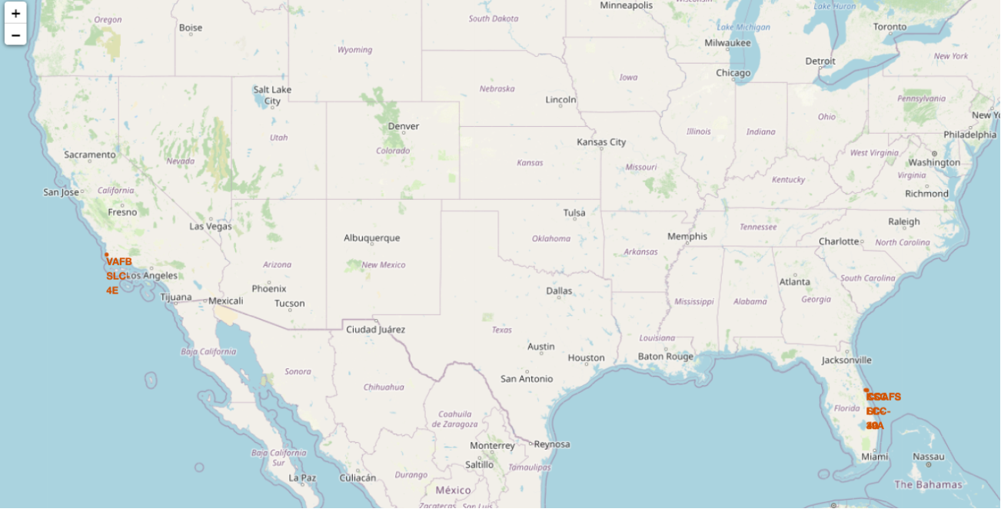
All Launch Sites Map
All the Launch Sites are USA near of sea cost sides.

Slide 38

Section 4

Slide 39
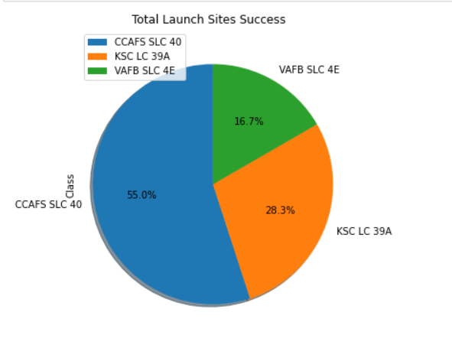
Total Success Launch Sites
Total Success Outcome rate by Launch Sites

Slide 40
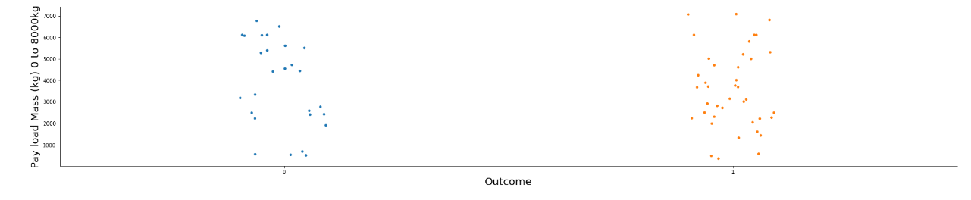
Dashboard Payload X Outcome
Range Payload Mass from 0 to 8000kg
Between these range we have number mix Success Rates for Success Mission and Failed.
We have had most Success rate from 2000kg to 6000kg.

Slide 41
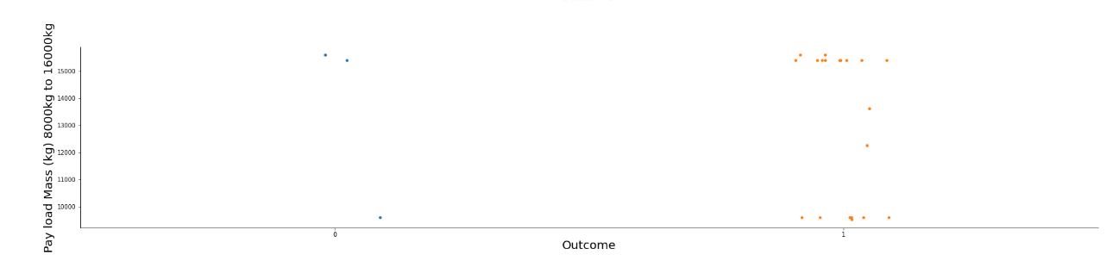
Dashboard Payload X Outcome
Range Payload Mass from 8000kg to 16000kg.
Between these range we have biggest number mix Success Rates.
We have had most Success rate at 10000kg and 16000kg.

Slide 42

Section 5

Slide 43
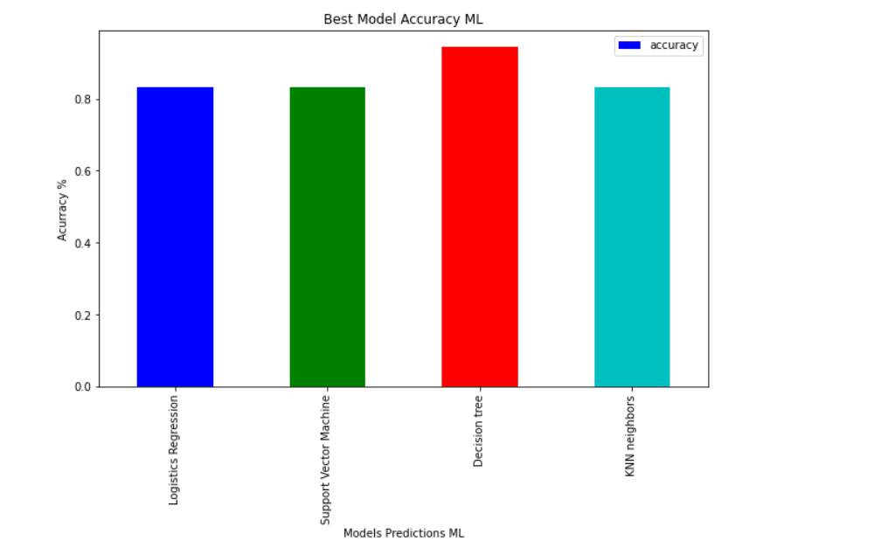
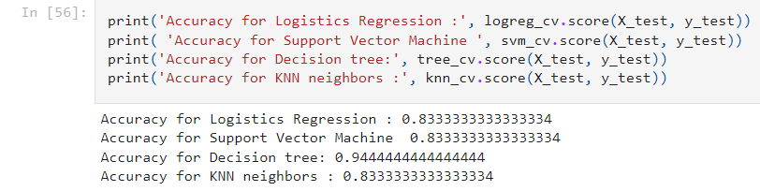
Classification Accuracy
The Best Model Accuracy is Decision Tree.

Slide 44
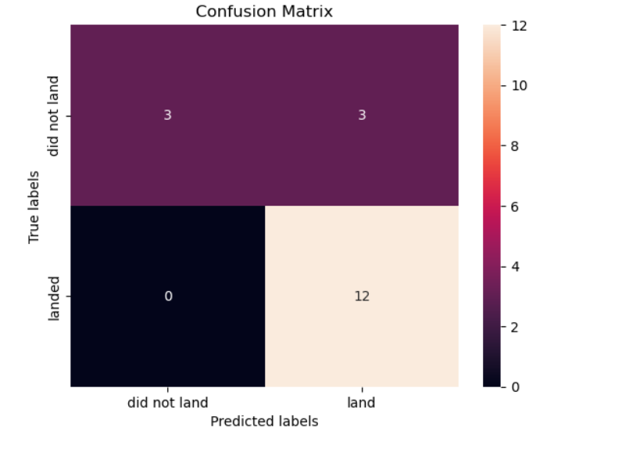
Confusion Matrix
The Decision Tree Model had the Best Model and Confusion Matrix of it, it is good and it can classifier as well.
Some observations are not correctly predictive value for Unsuccessful Landing for Success Landing.

Slide 45
Conclusions
CCFA SLC 40 Is the highest Success Launch Site rate.
Launch success rate started to increase in 2013 till 2020.
The Payload Mass have been increasing last flight missions.
Most of launch sites are near to sea, cost line and high , because good logistic.
LEO, VLEO and SSO are the best rate success outcomes.
Polar,LEO and ISS the highest payload mass.
The Descion Tree is chosen model for the support the
predict the Falcon 9 first stage will land successfully.

Slide 46


